Slide 1
SE305 Database System Technology
18/09/2018
Quiz-1

Slide 2
1. Which information is NOT the drawback of using file systems to store data?
a) Failures may leave database in an inconsistent state with partial updates carried out
b) Uncontrolled concurrent accesses can lead to inconsistencies
c) Security problems
d) Hard to provide user access to all data
2. Which is not the level of abstraction?
a) Physical Level
b) Logical Level
c) Database Level
d) View Level

Slide 3
3. Which option is NOT a data model?
a) Network model
b) Entity-Relationship data model
c) Object-relational model
d) Semi-Object model
4. Which statement about relational model is FALSE?
a) Collection of tables
b) Flat, “atomic” values
c) Semi-structured
d) Can contain null values

Slide 4
5. If K is chosen as the principal means of identifying tuples within a relation, then K is?
a) Superkey
b) Candidate Key
c) Primary Key
d) Foreign key
6. Which language is NOT a “Pure” language?
a) Relational algebra
b) Tuple relational calculus
c) Domain relational calculus
d) SQL

Slide 5
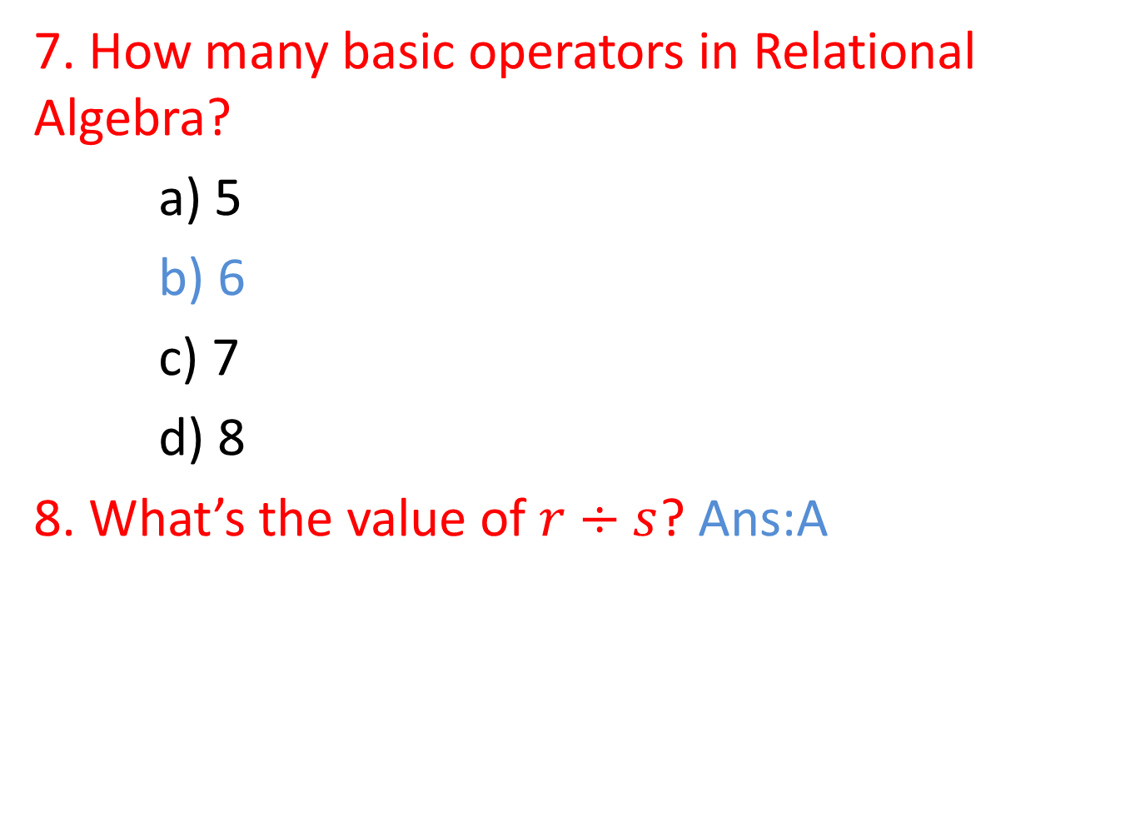
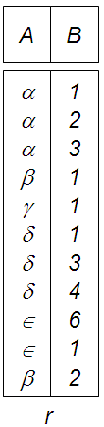






Slide 6
